Slide 1




2
Data Science
MentorrBuddy.com

Slide 2


2
INTRODUCTION TO
DATA SCIENCE
Lesson 1
Introduction to Data Science
Data Science
MentorrBuddy.com

Slide 3
2
What is Data Science?
Data science is an inter-disciplinary field that uses scientific methods, processes, algorithms and systems Data science is an inter-disciplinary field that uses scientific methods, processes, algorithms and systems to extract knowledge and insights from many structural and unstructured data. Data science is related to data mining of data.
Data science is a "concept to unify statistics, data analysis, machine learning and their related methods" in order to "understand and analyse actual phenomena" with data. It employs techniques and theories drawn from many fields within the context of mathematics, statistics, computer science, and information science. Turing award winner Jim Gray imagined data science as a "fourth paradigm" of science and asserted that "everything about science is changing because of the impact of information technology" and the data deluge
Data Science
MentorrBuddy.com

Slide 4
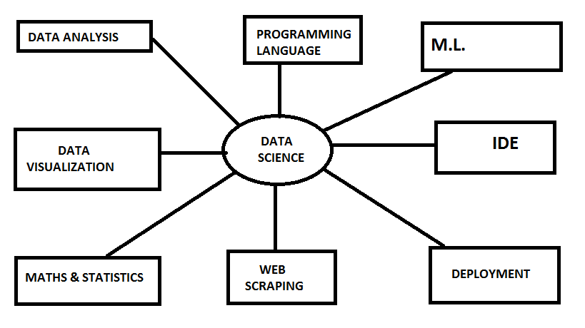
2
Data Science
MentorrBuddy.com

Slide 5

2
DATA ANALYSIS
Data analysis is a process of inspecting, cleansing, transforming and modelling data with the goal of discovering useful information, informing conclusion and supporting decision-making.
FEATURE ENGINEERING
EXPLORATORY DATA ANALYSIS
Data Science
MentorrBuddy.com

Slide 6
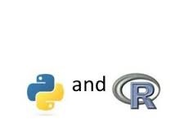
2
PROGRAMMING LANGUAGE
A programming language is a formal language, which comprises a set of instructions that produce various kinds of output. Programming languages are used in computer programming to implement algorithms.
PYTHON
R- LANGUAGE
EXCEL
Data Science
MentorrBuddy.com

Slide 7


2
INTEGRATED DEVELOPMENT ENVIRONMENT
An integrated development environment (IDE) is a software application that provides comprehensive facilities to computer programmers for software development. An IDE normally consists of at least a source code editor, build automation tools and a debugger.
JUPYTER
R STUDIO
Data Science
MentorrBuddy.com

Slide 8
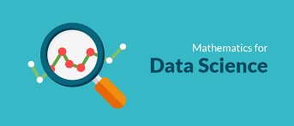
2
MATHS & STATISTICS
Data Scientist is a person who is better at statistics than any programmer and better at programming than any statistician.
Math and Statistics for Data Science are essential because these disciples form the basic foundation of all the Machine Learning Algorithms. In fact, Mathematics is behind everything around us, from shapes, patterns and colors, to the count of petals in a flower. Mathematics is embedded in each and every aspect of our lives.
Data Science
MentorrBuddy.com

Slide 9
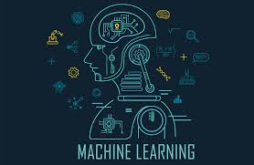
2
MACHINE LEARNING
Machine learning is a method of data analysis that automates analytical model building. It is a branch of artificial intelligence based on the idea that systems can learn from data, identify patterns and make decisions with minimal human intervention.
CLASSIFICATION
REGRESSIO
CLUSTERING
Data Science
MentorrBuddy.com

Slide 10

2
DATA VISUALIZATION
Data visualization is the graphical representation of information and data. By using visual elements like charts, graphs, and maps, data visualization tools provide an accessible way to see and understand trends, outliers, and patterns in data.
TABLEAU
POWER BI
Data Science
MentorrBuddy.com

Slide 11
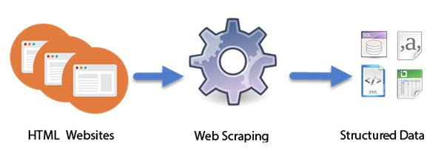
2
WEB SCRAPING
Web Scraping (also termed Screen Scraping, Web Data Extraction, Web Harvesting etc.) is a technique employed to extract large amounts of data from websites whereby the data is extracted and saved to a local file in your computer or to a database in table (spreadsheet) format.
Data Science
MentorrBuddy.com

Slide 12
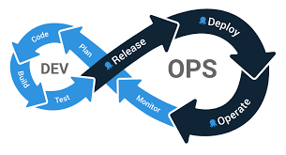
2
DEPLOYMENT
Software deployment is all of the activities that make a software system available for use. The general deployment process consists of several interrelated activities with possible transitions between them. These activities can occur at the producer side or at the consumer side or both.
AWS
FLASK AZURE
Data Science
MentorrBuddy.com

Slide 13
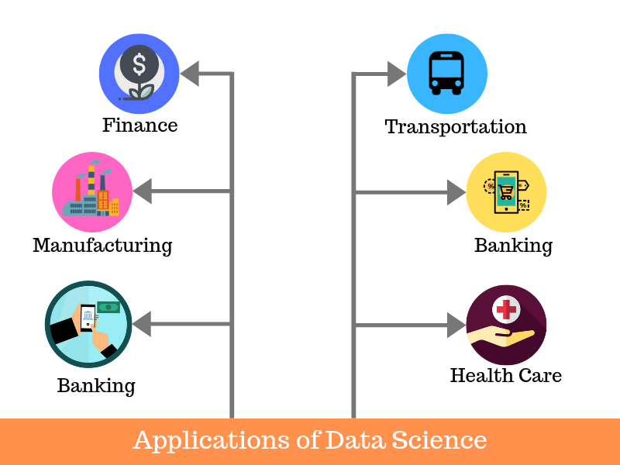
2
Applications of DS
Fraud and Risk Detection.
Healthcare.
Internet Search.
Targeted Advertising.
Website Recommendations.
Advanced Image Recognition.
Speech Recognition.
Airline Route Planning.
Data Science
MentorrBuddy.com

Slide 14
Importance of Data Science
Improving customer retention by finding out what the triggers of churn might be
Improving internal product development processes by looking at points where faults are most likely to happen
Targeting customers with the right sales messages at the right time
Informing product development by looking at how people use your products
Analysing customer sentiment on social media
Financial modelling
Data Science
MentorrBuddy.com

Slide 15
Thank you
Data Science
MentorrBuddy.com

